Slide 1
Ethical Student Hackers
Burp Suite

Slide 2
The Legal Bit
The skills taught in these sessions allow identification and exploitation of security vulnerabilities in systems. We strive to give you a place to practice legally, and can point you to other places to practice. These skills should not be used on systems where you do not have explicit permission from the owner of the system. It is VERY easy to end up in breach of relevant laws, and we can accept no responsibility for anything you do with the skills learnt here.
If we have reason to believe that you are utilising these skills against systems where you are not authorised you will be banned from our events, and if necessary the relevant authorities will be alerted.
Remember, if you have any doubts as to if something is legal or authorised, just don't do it until you are able to confirm you are allowed to.
Relevant UK Law: https://www.legislation.gov.uk/ukpga/1990/18/contents

Slide 3
Code of Conduct
Before proceeding past this point you must read and agree to our Code of Conduct - this is a requirement from the University for us to operate as a society.
If you have any doubts or need anything clarified, please ask a member of the committee.
Breaching the Code of Conduct = immediate ejection and further consequences.
Code of Conduct can be found at shefesh.com/conduct

Slide 4
What You Need
There’s not much you need before this session, but these will help:
What you should bring:
Basic understanding of HTTP (requests, responses, methods, parameters)
Burp Suite Community Edition (free from portswigger.net)
A free PortSwigger Web Security Academy account

Slide 5
What is Burp Suite?
Burp Suite is an integrated platform for testing the security of web applications. It sits between your browser and the target site, letting you intercept, inspect, and modify every request that passes through.
It comes in three editions; we’ll use the free Community Edition, which gives us the core tools:
Proxy — intercept and modify HTTP/HTTPS traffic in real time
Repeater — manually replay and tamper with a single request
Intruder — automate fuzzing and brute-force attacks across payloads
Decoder & Comparer — encode/decode data and diff two responses
Target & Site Map — passively map out every endpoint as you browse

Slide 6
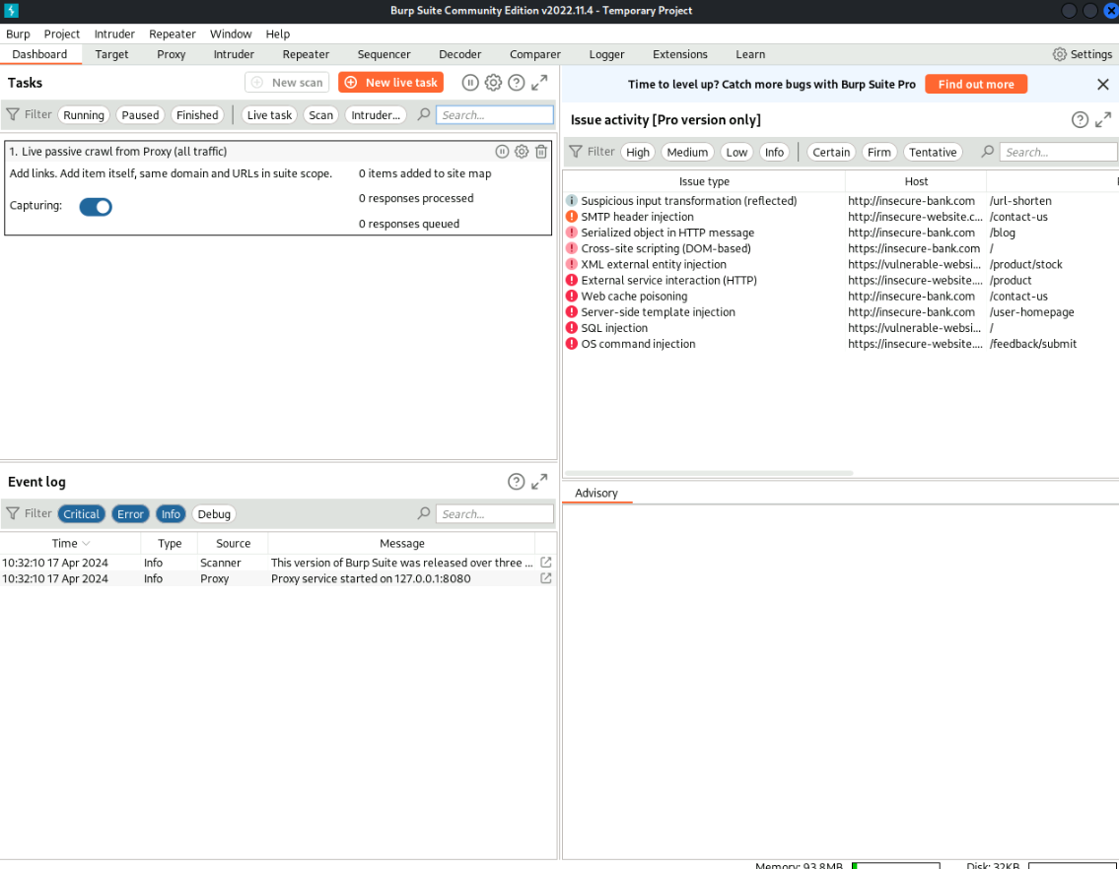

Slide 7
The Proxy
The Proxy sits between your browser and the target server. Every HTTP/S request and response passes through Burp, and you decide what happens next.
With Intercept ON, requests pause until you forward or drop them. You can edit any part — headers, body, parameters — before it reaches the server.
With Intercept OFF, every request still appears in HTTP history. Right-click any request to send it to Repeater, Intruder, or any other tool.
Default listener: 127.0.0.1:8080. The embedded browser routes through this automatically.

Slide 8
Repeater
Repeater is for manual, one-at-a-time request tweaking. You change a value, click Send, read the response, repeat.
Send any interesting request from Proxy history to Repeater with Ctrl+R (or right-click → Send to Repeater).
This is where 90% of manual web testing happens: find a suspicious request, send it to Repeater, tweak parameters, watch responses. Great for testing single payloads — SQL injection, XSS, IDOR, auth flaws.
Docs: portswigger.net/burp/documentation/desktop/tools/repeater

Slide 9
Intruder
Intruder automates Repeater. Instead of changing one value at a time, you mark a position in the request and supply a wordlist — Burp sends one request per payload and shows you every response side-by-side.
Sort the results by response length or status code — the row that’s different is usually the valid username, the working password, or the exploitable parameter.
Community Edition rate-limits Intruder severely — fine for learning, painful for real workloads. Pro removes the limit; Turbo Intruder (BApp Store) is the free workaround.

Slide 10
Intruder Attack Types
Sniper — one payload list, cycled through each marked position one at a time. Default choice. Best for testing one parameter at a time.
Battering ram — one payload list, the same payload placed into all marked positions simultaneously.
Pitchfork — one payload list per position, in parallel. Good for testing matched user/password pairs.
Cluster bomb — one payload list per position, every combination tried. Most powerful but slowest. 100 users × 1000 passwords = 100,000 requests.

Slide 11
Example Walkthrough
Practical Easy in 7 steps. The same loop works for every lab in this session:
Open Burp → Proxy tab → click “Open Browser”
In that browser, open the lab and click the “Gifts” category
Back in Burp: Proxy → HTTP history → find GET /filter?category=Gifts
Right-click that request → Send to Repeater (or Ctrl+R)
Switch to Repeater tab. Edit the request: change category=Gifts to category=Gifts'+OR+1=1--
Click “Send” (top-left in Repeater). Read the response on the right pane
Loop: edit → Send → read. Keep tweaking until you see all products listed
Rule of thumb: keep Intercept OFF unless you actually need to pause something. HTTP history captures everything anyway.

Slide 12
Practicals
Easy: https://portswigger.net/web-security/sql-injection/lab-retrieve-hidden-data
Use Proxy + Repeater to display unreleased products on the shop. PortSwigger Lab: “SQL injection vulnerability in WHERE clause allowing retrieval of hidden data”
Medium: https://portswigger.net/web-security/sql-injection/lab-login-bypass
Log in as the administrator without knowing the password. PortSwigger Lab: “SQL injection vulnerability allowing login bypass”
Hard: https://portswigger.net/web-security/logic-flaws/examples/lab-logic-flaws-excessive-trust-in-client-side-controls
Buy a leather jacket for less than its real price by tampering with the request. PortSwigger Lab: “Excessive trust in client-side controls”

Slide 13

Feedback
Please leave your feedback :) We want to know what we can do to improve.
Please leave constructive and honest feedback only.
https://forms.gle/VTYd74K5BHqbC7F68
Notes:
Links still work!

Slide 14
Upcoming Sessions
What’s up next?
www.shefesh.com/sessions

Slide 15

Any Questions?
www.shefesh.com
Thanks for coming!

